Slide 1
7 Ways to Approach a Top REALTOR®
with Michael Maher
June 18, 2014

Slide 2
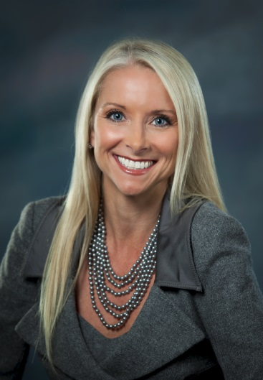
Welcome and Introduction
Sue Woodard
President Vantage Production
Michael Maher
Founder
Generosity Generation
International Best Selling Author

Slide 3
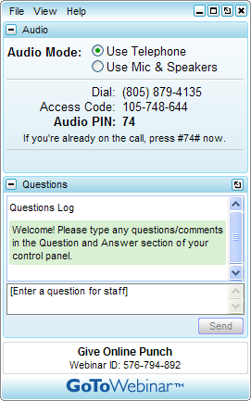
Housekeeping If you can’t hear us, please call the number on your invitation email or dashboard. We’re using a phone line, not mic & speakers.
To Dial In To Ask Questions

Slide 4
Today’s Agenda
Best way to approach a Top Realtor®
Who to approach and what NOT to do
Learn the power of the Triangle of Trust
Give updates!
The Purple Cow strategy
Its all about relationships
Leverage ‘The Gift Of Generosity’

Slide 5
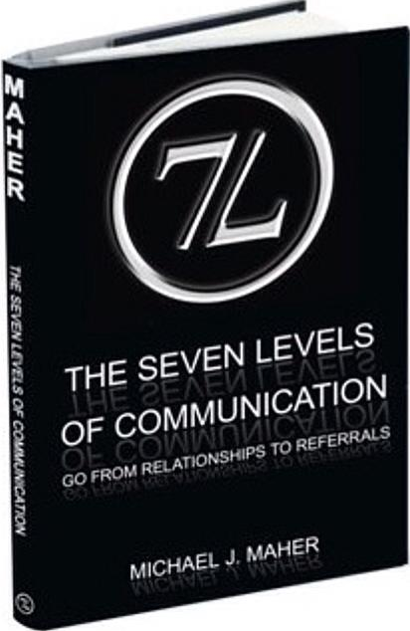
About Michael Maher
Michael J. Maher is the proud father and founder of The Generosity Generation; a group of like-minded givers professionals who understand that giving and receiving are two sides of the same coin.
His book, (7L) The Seven Levels of Communication: Go from Relationships to Referrals is an International Bestseller.

Slide 6
The Best Way To Approach Top Realtors®
Get Real-Time Referrals!!
Post NOW on your Facebook Status:
“Quick question for my non-Realtor friends… out of curiosity, if a friend or neighbor were looking to SELL their home, who would you recommend they call FIRST?”

Slide 7
The Best Way To Approach Top Realtors®
How did you get your last…
Great Realtor® Referral Relationship?

Slide 8
Who To Approach and What NOT To Do #1 How to Approach
The #1 Best Way to Approach a Realtor® is to refer them pre-approved buyers (or ready sellers).

Slide 9
Who To Approach and What NOT To Do Repeat after me…
No.
More.
Donuts!
☺

Slide 10
The End.

Slide 11
Who To Approach and What NOT To Do
The Top Realtor® may not be your ideal target!
It may be…
The buyers’ agent.
Open house approach!

Slide 12
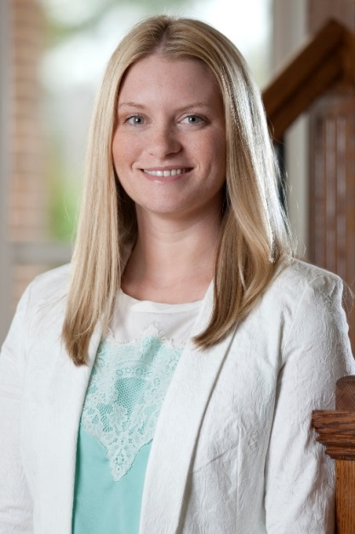
Who To Approach and What NOT To Do #2 Approach Buyer’s Agent
“Mine asked to bring our team lunch probably 6 times and we said no. He approached my buyers’ agent. (It can be hard to get ahold of me). When I met him and heard what he believed in, I knew he was a great match for us. Now, I teach my entire team how to show buyers the benefit of using him as our preferred lender because they are guaranteed the best service possible. We aim to be the #1 referred real estate team in Athens and North Georgia and he's one of the crucial pieces of the puzzle that make that possible.”
Brittany Purcell
Top Agent
NAR 30 under 30 candidate

Slide 13
#3: The Triangle of Trust Current Realtor Relationship
Y☺U (New Relationship)

Slide 14
Triangle of Trust (example)

Slide 15
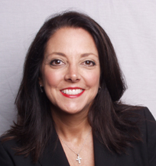
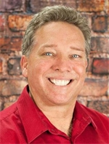
The Triangle of Trust Agent Referral
Michele Herndon, one of the top-producing Realtors in Tampa, FL said, “I chose both of my preferred partners by referral (by other agents) - both were referred to me and we found we have similar business models. I actually used one for our mortgage before we developed our partnership.”
Tom Cain, Certified Referral Coach, Star Power Star® and RE/MAX top agent, “My current lender relationship was established when I was not able to get a loan closed where I usually do my business and I tried a new lender who was referred to me by another realtor.”

Slide 16
Give Updates #4: Update ALL Parties*
Do you have a standard set of milestones that trigger communication in your process?
If not, do that. ☺
If so, start including a plan for the Listing Agent to be included on all communication during the transaction.
*Please check with compliance for confidentiality and any other duties. It’s a risk, but it’s a risk worth doing right.

Slide 17
Give Updates #4: Update Listing Agent Regularly
Cynthia Matheny of Charlotte, NC didn’t find the lender’s communication intrusive or disruptive!
“I switched from my last lender to one who had been consistently following up with me via handwritten note and an occasional email. I only have one "preferred" lender but have a few additional options for clients who want to "shop". The most important thing I am looking for in a lender is one who communicates throughout the transaction without me having to reach out first…”
Stacey Booker, a rising star in Spring Hill, TN
“Mine represented the buyer on one of my new construction listings. He kept me so up-to-date! I sent him Buyers for 2 years before I ever met him in person. He is now a great friend with an amazing desire to grow and help me grow. Relationships and communication are key!”

Slide 18
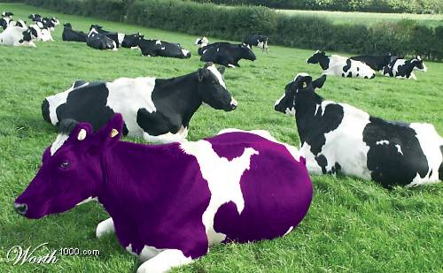
The Purple Cow Strategy #5: Be Different. Be Better.
What product do you win with every time?

Slide 19
The Purple Cow Strategy #5: Product Differentiation
Where do you WIN?
Doctor’s Loan
203K Renovation
Conventional Renovation
80
Bridge
Construction to Perm
#1 Fastest Growing Niche for my Coaching Clients who are Lenders…
Referrals from Other Lenders
What products do they have that you could refer out (renovation?) and what products do you have that they don’t (Doctors? Portfolio? Self-employed?)

Slide 20
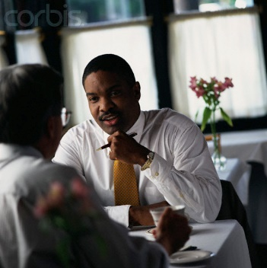
#6: It’s All About Relationships
Build The Relationship BY Helping Them Build Their Business.
Build Their Business to Build Your Business.

Slide 21
It’s All About Relationships Want to work with #1?
Try these numbers on for size:
1420 transactions, $264 Million in volume and $5.9 Million Gross Commission Income
Great career right?!
That was LAST YEAR for Keller Williams’ #1 Agent: Mark Spain of Atlanta, GA
“My biggest mortgage relationship moved with me from my previous company. He's NOW our office’s in-house lender as well as one of my lenders. He stayed in touch with us and as opportunities arose, they got the business.”
Mark Spain wasn’t always MARK SPAIN. His current lender built a strong referral relationship with Mark when Mark was just an Buyers’ Agent with his dad.
“MY lender is the king of contact! He sent cards all the time... mainly handwritten! Our daughters ride horses and he'd see me at a horse show. The following week I'd get a card saying ‘great to see you this weekend...’! He still does it to this day! Got one this week with ‘just wanted to say thanks for doing business with me’! He never lets up or takes the business for granted. Constantly works and earns it!”

Slide 22
It’s All About Relationships Take a sincere interest in helping them grow…
Two Questions:
What are your goals?
What is your biggest challenge right now?
Go from Relationships to Referrals… it’s easier than you think. Help others achieve their goals and conquer their challenges.

Slide 23
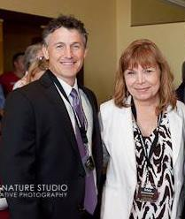
It’s All About Relationships It’s Easier than You Think…
“My lender, Brian McRae of First National Bank of St. Louis asked me, “What's your greatest challenge right now? How can I help you with that? What can I do to help you grow your business?” Brian is so good we reference their programs (and services) on our MLS marketing remarks and have their info at all our listings. Makes MY life SO much easier!”
~ Mary Krummenacher, Top Realtor, St. Louis MO

Slide 24
WHAT?
No cold calling?
No dropping by the Office?
No MSAs?
No joint ventures?
No in-house lending?
Um…

Slide 25
It’s All About Relationships Most Importantly…
No.
More.
Donuts!
☺

Slide 26
It’s All About Relationships Take Action… DO IT NOW!
Make sure you are approaching the right person
Implement the Triangle of Trust
Update ALL parties (2 for 1 deal!)
Be different. Be better.
Build… the relationship by building… THEIR Business.
Implement a Gift of Generosity (learning-based).
To bring me in to speak e-mail TheGenerosityGeneration@Gmail.com.
Follow me at www.Facebook.com/ReferralGuru
Please sign up and spread the word about www.FREEBonusWebinar.com.

Slide 27
#7 Leverage The Gift of Generosity
Secret to Life, Love, and Business:
“Give Generously & Receive Appreciatively.” ~ Michael J. Maher

Slide 28
The Gift of Generosity
Exciting News!
ANNOUNCEMENT!
Michael Maher interviews top Real Estate producers and business leaders for the Gift of Knowledge Series
Open doors
Differentiate yourself from your competition
Brand yourself as a valued partner
Build strong referral partner relationships
Gain more referrals
Available exclusively from Platinum Marketing

Slide 29
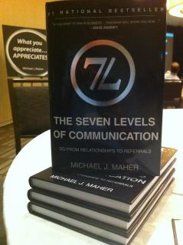
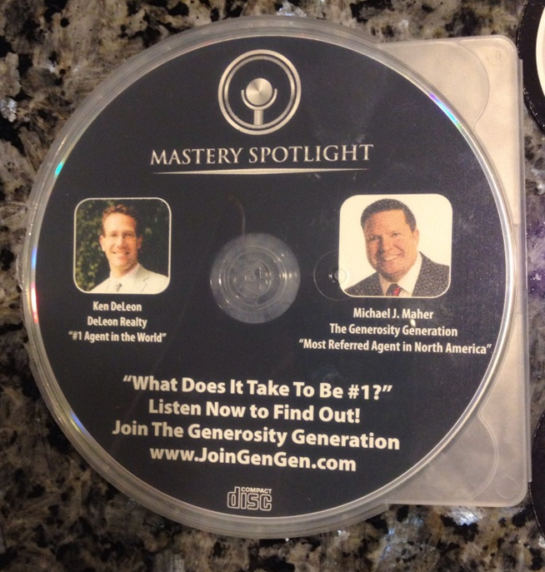
The Gift of Generosity
Lead with a Gift of Generosity…
←Learning-Based Books
Audio/Video Interviews with Top Agents →

Slide 30
The Gift of Generosity Just For Registering…
Go to www.FREEBonusWebinar.com A free bonus on Referral Mastery.
Register now (limited space, 41 seats left going into this Webinar)
When? Wednesday, June 25 from 3:00 PM - 4:00 PM Eastern
Learn the most important goal any business should set.
Learn the one question you should ask everyone when entering a referral relationship.
Learn ONE SIMPLE AND POWERFUL QUESTION that immediately gives you knowledge about whether another professional will make a great referral source or not…

Slide 31
Q&A
Michael Maher
Founder
Generosity Generation
International Best Selling Author

Slide 32
The Gift of Generosity Q&A
Thanks to everyone who submitted questions during the webinar. With dozens of questions submitted, we know many of you did not get your questions answered. We aim to serve by giving you some additional resources:
For Michael to answer your question directly, please join the conversation at www.Facebook.com/ReferralGuru.
For Michael's Gift of Generosity, his free bonus Webinar he agreed to do, go to www.FREEBonusWebinar.com to register. Warning: There is limited space for this webinar. Please contact Michael at 1-800-752-4363 if the webinar is full.
One of the most powerful ways to open the door to Referral Relationships is to have Michael speak in your area. To book a Generosity Generation event - in many cases for low or even no cost to you - contact Michael and his GenGen Team at TheGenerosityGeneration@Gmail.com. Note: Dates book fast. Contact Michael today as much of 2014 is already booked, and bookings for 2015 are already in process.
There was a lot of buzz about The Gift of Knowledge re-launch on Platinum Marketing. All answers to those questions will be handled individually. Look for press releases and announcements this summer. To say we are VERY excited about this is an understatement. Thank YOU for being a part of our growth and continued expansion!

Slide 33
Thank you for attending
7 Ways to Approach
a Top REALTOR®
With Michael Maher
Want to learn more? Call 1-800-963-1900 or visit mortgagemarketguide.com

